Slide 1
Artificial intelligence
Autumn 2008
Instructor: Wang Xiaolong
Harbin Institute of Technology, Shenzhen Graduate School
Intelligent Computation Research Center
(HITSGS ICRC)

Slide 2
XIV. Bayesian networks
(section 1-3)
Autumn 2008
Instructor: Wang Xiaolong
Harbin Institute of Technology, Shenzhen Graduate School
Intelligent Computation Research Center
(HITSGS ICRC)

Slide 3
Outlines
Syntax
Semantics
Parameterized distributions

Slide 4
Bayesian networks
A simple, graphical notation for conditional independence assertions and hence for compact specification of full joint distributions
Syntax:
  a set of nodes, one per variable
  a directed, acyclic graph (link ≈ "directly influences")
  a conditional distribution for each node given its parents:
    P (X_{i} | Parents (X_{i}))
In the simplest case, conditional distribution represented as a conditional probability table (CPT) giving the distribution over X_{i} for each combination of parent values

Slide 5

Example
Topology of network encodes conditional independence assertions:
Weather is independent of the other variables
Toothache and Catch are conditionally independent given Cavity

Slide 6
Example
I'm at work, neighbor John calls to say my alarm is ringing, but neighbor Mary doesn't call. Sometimes it's set off by minor earthquakes. Is there a burglar?
Variables: Burglary, Earthquake, Alarm, JohnCalls, MaryCalls
Network topology reflects "causal" knowledge:
  A burglar can set the alarm off
  An earthquake can set the alarm off
  The alarm can cause Mary to call
  The alarm can cause John to call

Slide 7
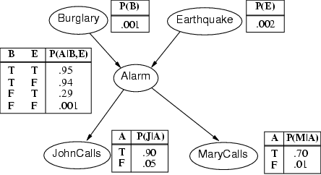
Example contd.

Slide 8
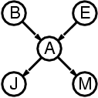
Compactness
A CPT for Boolean X_{i} with k Boolean parents has 2^{k} rows for the combinations of parent values
Each row requires one number p for X_{i} = true
(the number for X_{i} = false is just 1-p)
If each variable has no more than k parents, the complete network requires O(n · 2^{k}) numbers
I.e., grows linearly with n, vs. O(2^{n}) for the full joint distribution
For burglary net, 1 + 1 + 4 + 2 + 2 = 10 numbers (vs. 2⁵-1 = 31)

Slide 9
Semantics
The semantics of Bayesian networks:
  A representation of the joint probability distribution.
  (Numerical semantics)
  An encoding of a collection of conditional independence statements.
  (Topological semantics)

Slide 10
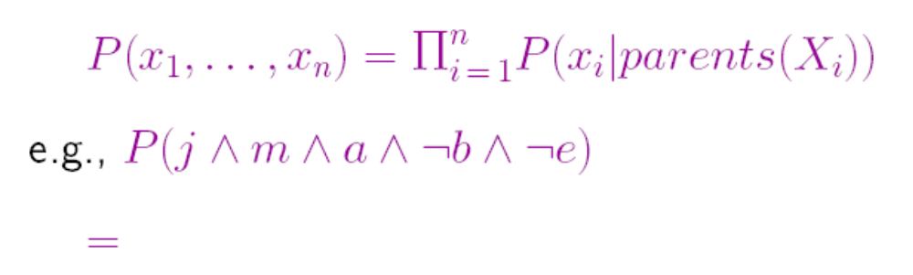
Numerical semantics
The full joint distribution is defined as the product of the local conditional distributions:

Slide 11
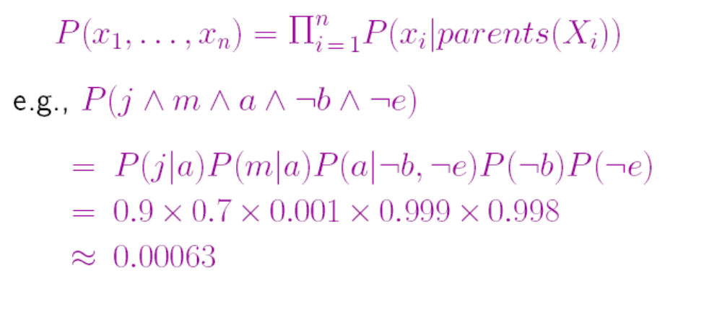
Numerical semantics
The full joint distribution is defined as the product of the local conditional distributions:

Slide 12
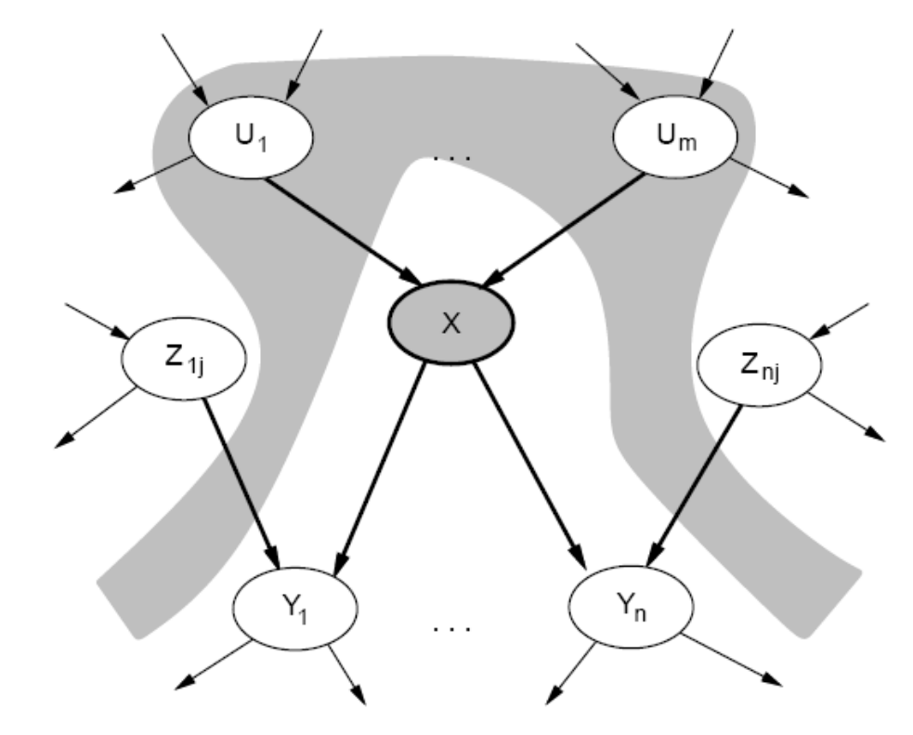
Topological semantics
Topological semantics:
  Each node is conditionally independent of its non-descendants given its parents

Slide 13
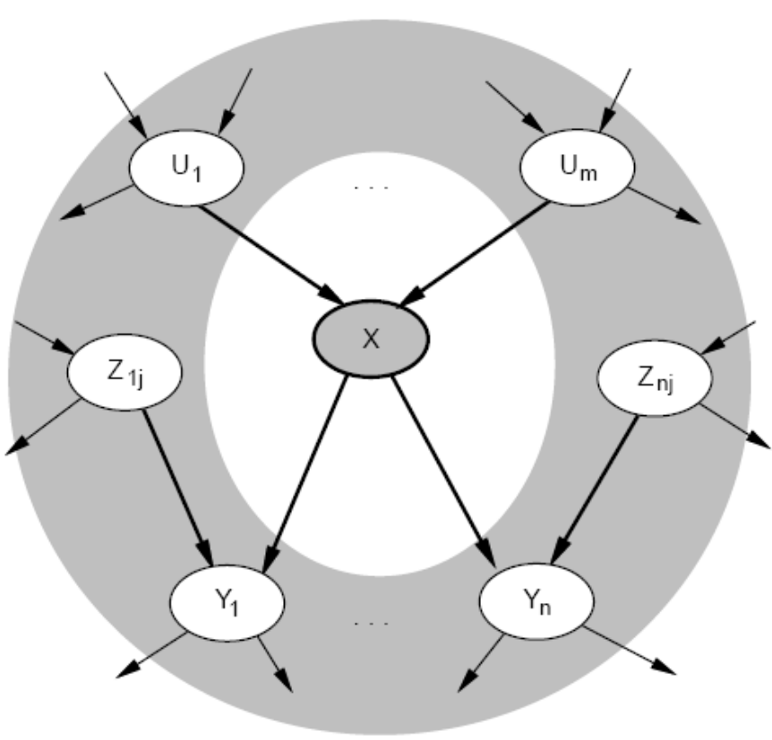

Markov blanket
  Each node is conditionally independent of all others given its Markov blanket: parents + children + children's parents
Theorem: Topological semantics Numerical semantics

Slide 14
Constructing Bayesian networks
1. Choose an ordering of variables X₁, … ,X_{n}
2. For i = 1 to n
    add X_{i} to the network
    select parents from X₁, … ,X_{i-1} such that
  P (X_{i} | Parents(X_{i})) = P (X_{i} | X₁, ... X_{i-1})
This choice of parents guarantees:
P (X₁, … ,X_{n}) = π_{i =1} P (X_{i} | X₁, … , X_{i-1})
= π_{i =1}P (X_{i} | Parents(X_{i}))
(by construction)
(chain rule)
n
n

Slide 15
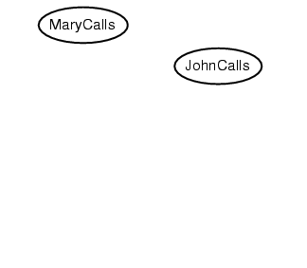
Example
Suppose we choose the ordering M, J, A, B, E
P(J | M) = P(J)?

Slide 16
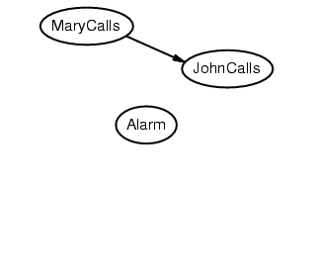
Example
Suppose we choose the ordering M, J, A, B, E
P(J | M) = P(J)?
P(A | J, M) = P(A | J)? P(A | J, M) = P(A)?
No

Slide 17
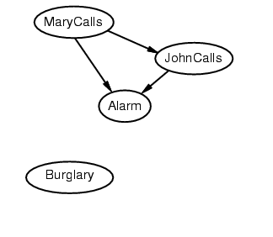
Example
Suppose we choose the ordering M, J, A, B, E
P(J | M) = P(J)?
P(A | J, M) = P(A | J)? P(A | J, M) = P(A)? No
P(B | A, J, M) = P(B | A)?
P(B | A, J, M) = P(B)?
No

Slide 18
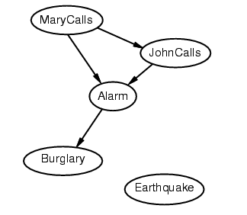
Example
Suppose we choose the ordering M, J, A, B, E
P(J | M) = P(J)?
P(A | J, M) = P(A | J)? P(A | J, M) = P(A)? No
P(B | A, J, M) = P(B | A)? Yes
P(B | A, J, M) = P(B)? No
P(E | B, A ,J, M) = P(E | A)?
P(E | B, A, J, M) = P(E | A, B)?
No

Slide 19
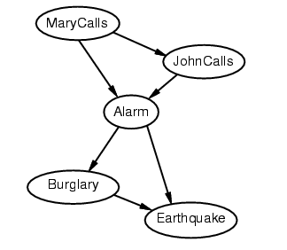
Example
Suppose we choose the ordering M, J, A, B, E
P(J | M) = P(J)?
P(A | J, M) = P(A | J)? P(A | J, M) = P(A)? No
P(B | A, J, M) = P(B | A)? Yes
P(B | A, J, M) = P(B)? No
P(E | B, A ,J, M) = P(E | A)? No
P(E | B, A, J, M) = P(E | A, B)? Yes
No

Slide 20
Example contd.
Deciding conditional independence is hard in noncausal directions
(Causal models and conditional independence seem hardwired for humans!)
Network is less compact: 1 + 2 + 4 + 2 + 4 = 13 numbers needed

Slide 21
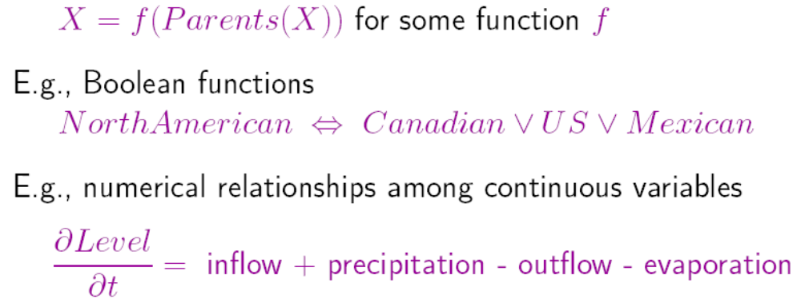
Compact conditional distributions
CPT grows exponentially with number of parents (O(2^{k}) )
CPT becomes infinite with continuous-valued parent or child
Solution: canonical distributions that are defined compactly
Deterministic nodes are the simplest case:

Slide 22
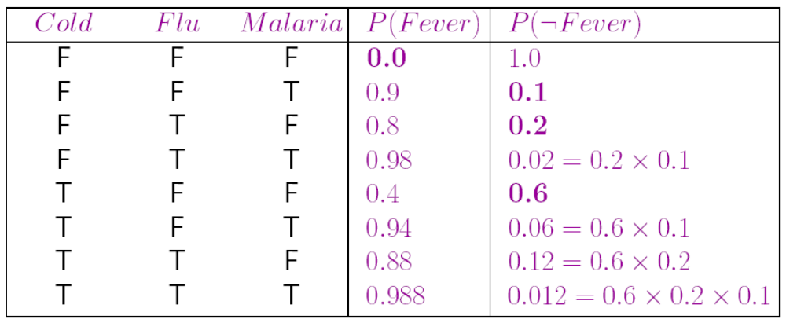
Compact conditional distributions contd.
Noisy-OR distributions model multiple noninteracting causes
1) Parents U₁…U_{k} include all causes (can add leak node)
2) Independent failure probability q_{i} for each cause alone
Number of parameters linear in number of parents (O(k))

Slide 23
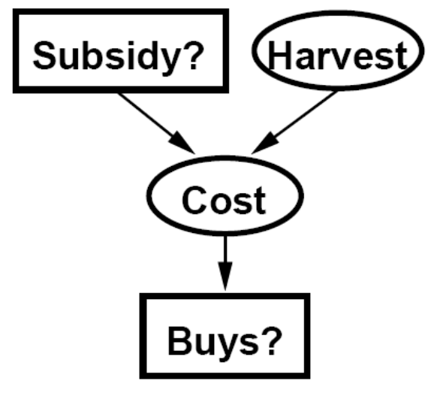
Hybrid (discrete+continuous) networks
Discrete (Subsidy? and Buys?); continuous (Harvest and Cost)
Option 1: discretization——possibly large errors, large CPTs
Option 2: finitely parameterized canonical families
1) Continuous variable, discrete+continuous parents (e.g., Cost)
2) Discrete variable, continuous parents (e.g., Buys?)

Slide 24
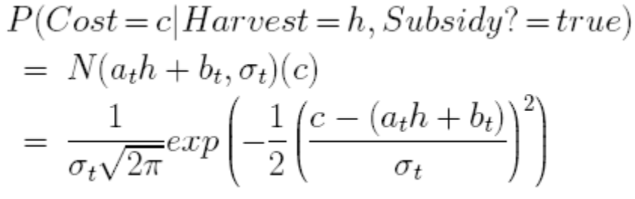
Continuous child variables
Need one conditional density function for child variable given continuous parents, for each possible assignment to discrete parents
Most common is the linear Gaussian model, e.g.,:
Mean Cost varies linearly with Harvest, variance is fixed
Linear variation is unreasonable over the full range,
but works OK if the likely range of Harvest is narrow

Slide 25
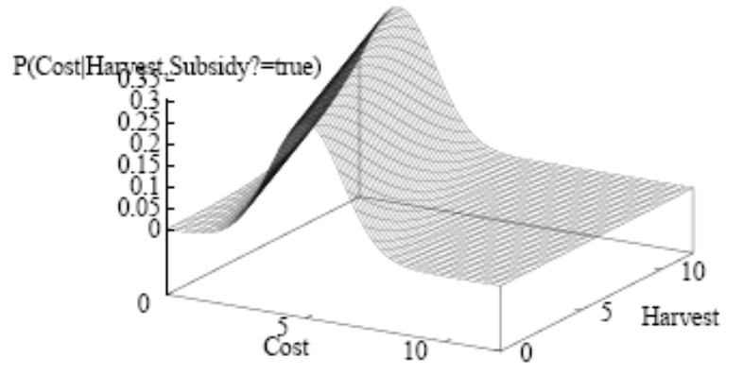

Continuous child variables
All-continuous network with LG distributions
full joint distribution is a multivariate Gaussian
Discrete+continuous LG network is a conditional Gaussian network
  i.e., a multivariate Gaussian over all continuous variables for each combination of discrete variable values

Slide 26
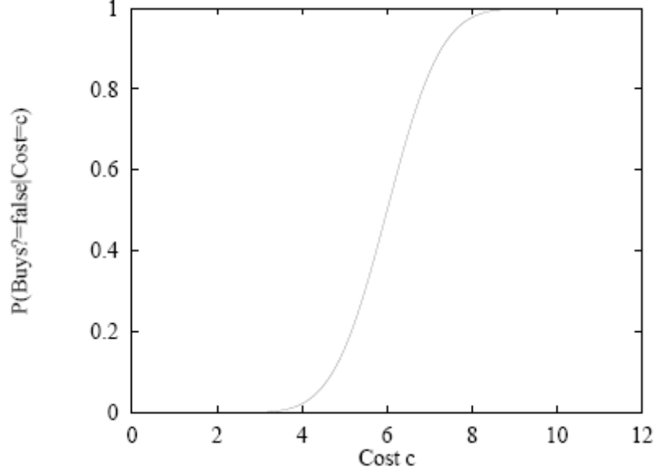
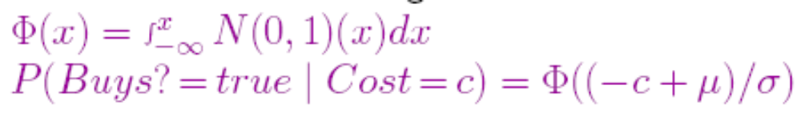
Discrete variable with continuous parents
Probability of Buys given Cost should be a “soft” threshold:
Probit distribution uses integral of Gaussian:

Slide 27
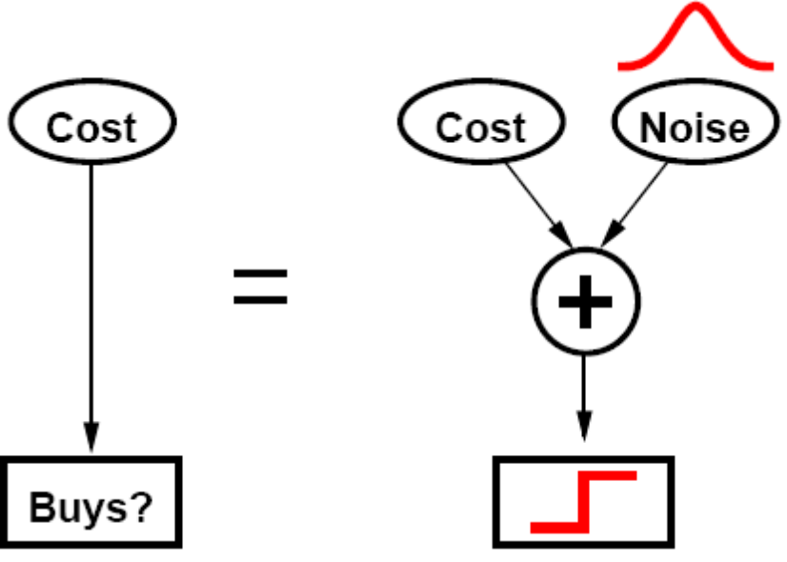
Why the probit?
1.It's sort of the right shape
2. Can view as hard threshold whose location is subject to noise

Slide 28
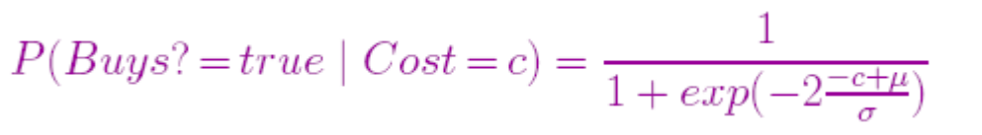
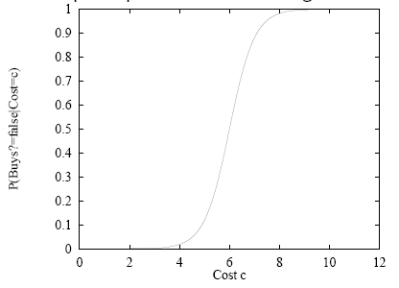
Discrete variable contd.
Sigmoid (or logit) distribution also used in neural networks:
Sigmoid has similar shape to probit but much longer tails:

Slide 29

Summary
Bayesian networks provide a natural representation for (causally induced) conditional independence
Topology + CPTs = compact representation of joint distribution
Generally easy for domain experts to construct
Canonical distributions (e.g., noisy-OR) = compact representation of CPTs
Continuous variables parameterized distributions (e.g., linear Gaussian)

